Slide 1
Les Assises de la Recherche et de l’Innovation 2022 Financial Innovation 28 April 2022 Mrs DOVINASSY Pillay-Naiken

Slide 2
WHY IS INNOVATION IMPORTANT FOR MAURITIUS?

Slide 3
Why is Financial Innovation important ?
Financial Services contributes to 13% of the GDP
The sector is expected to double its contribution by 2030
Mauritius has already stepped into the fintech space
Mauritius wants to position itself as a fintech hub
Mauritius has the potential to be a fintech hub for the African region
Financial innovation is the act of creating new financial instruments as well as new financial technologies, institutions, and markets.
The Financial Services sector represents an important pillar of our economy.
We have noted that this is one of the most resilient sectors which has even shown growth inspite of the effects of the Covid 19 pandemic.
The strategy of our jurisdiction is to strengthen this sector by bringing innovative spin to financial services.

Slide 4
THE TECHNICAL COMMITTEE on Financial innovation

Slide 5
Members of Technical Committee
Name | Institution
Mr Vinod Bussawah | Mauritius Finance
Mr Geetesh Gungah | Economic Development Board
Mr Rajnish Hawabhay | Ministry of Information and Communication Technology
Mr Jamsheed Khadaroo | Financial Services Commission
Mr K. Koonjal | Independent Commission Against Corruption
Mr Ashwin Jankee | Mauritius Bankers Association Ltd
Ms Tilotma Jhurry | Bank of Mauritius
Dr Bhavish Jugurnath | University of Mauritius
Mrs Varsha Mooneeram – Chadee | University of Mauritius
Mr Avinash Nemchand | Financial Services Commission
Mr Roshan Oree | Mauritius Revenue Authority
Mrs. Dovinassy Pillay-Naiken | Ministry of Financial Services and Good Governance
Mr Faraz Rojid | Economic Development Board

Slide 6
Scope of the Technical Committee
Meeting on 16 February 2022
Meeting on 23 February 2022
Meeting on 04 March 2022
Notes of Meeting have been circulated to members
EDB made a presentation on Residency Permit
Developing the FinTech Strategy for Mauritius by MFSGG
Draft of Report circulated to the Members
Final report circulated on
The discussion of the Working Group was focused around the following questions:
Where we are?
Situating the existing financial eco-system
Identifying the gaps and challenges in the Sector
Where we want to go?
Understanding the aspirations and vision for the sector over the coming years
How to reach there?
New policies and strategic directions
New laws and regulations or amendment of existing legislation
Actions (Innovative ideas, solutions to gaps identified, best practices, projects etc)
New Schemes/ support Mechanisms

Slide 7
STRUCTURE of our presentation and panel.
What have we achieved locally and in comparison with international trends?
Where do we want to go?
What are the challenges ?
Panel discussion – How do we reach there?

Slide 8
WHAT HAVE WE DONE TO IMPLEMENT FINANCIAL INNOVATION LOCALLY?

Slide 9
BLUEPRINT THE ROADMAP OF 10 YEARS
To double the contribution of financial services sector to at least 26% to GDP by 2030.
To position Mauritius as an International Financial Centre of repute and substance
To position Mauritius as the ideal platform for investment for African region
Blueprint Key pillars
Corporate Banking
Cross Border Investment
6 Imperatives
Future proof fiscal and regulatory regime
Simple and user friendly processes to serve investors
Additional Opportunities
Innovative Capital Markets
Asset Management
Private Banking and Wealth Management
Reputation and Image Building
Attract , retain and develop our talent
Attract high calibre corporates
Infrastructure
Captive Insurance
Fintech
Cryptocurrency and Blockchain technology
Reinsurance
Islamic Finance

Slide 10
Financial Innovation – CROSS SECTORS
Financial Services
Information Technology
Blue and Green Development
Green Bond and Blue Bonds
Fintech

Slide 11
Current Situation in Mauritius?
Policy
Position Mauritius as a fintech hub
Ministry of Financial Services and Good Governance
Ministry of Information and Communication Technology
Blueprint for the Financial Services Sector
A report was issued as the Blueprint for the Fintech sector known as "Mauritius: Roadmap for a Regional Fintech Hub“
A series of Budget measures to prioritise Fintech development in Mauritius as from 2019.
Implementation of a Sustainable Financing Framework 2020
Institutional
Signature of a Cooperation Agreement between the FSC and Autorite des Marches Financiers to promote the Fintech sector in Mauritius
Legal Framework
Electronic Transaction Act 2002
Setting up of the Mauritius Africa Fintech Hub
A new sandbox framework will be introduced for development of proof of concepts and pilot exercises
Setting up of a Technical Committee to look into the development of fintech sector in Mauritius. (Regulatory and product development)
National Payment Switch Act
Virtual Asset and Initial Token Offering Act 2022

Slide 12
Question 1
For Mauritius to become a Digital Society and accelerate the growth of Fintech , Digital KYC and Customer Due Diligence must be embraced in all processes?
[You have 1 minute to select your answer]

Slide 13
HOW BANKING SECTOR IMPLEMENTED FINANCIAL INNOVATION?
Institution/Framework
Digital Banking Guidelines
Products
Mobile Banking Apps: MCB JuicePro, SBM Mobile Banking, Pop, Absa Mauritius, Yono SBI Mauritius, MauBank WithMe, M-Connect Plus Mauritius, BCP Bank Mauritius Direct Mobile
Setting up the Mauritius Central Automated Switch (MauCAS)
Processes
Section 52 of the Bank of Mauritius Act was amended in July 2019 to enable Fintechs providing peer to peer lending facilities to have access to information from the Mauritius Credit Information Bureau.
The Bank is working on a centralized e-KYC system and on a connection to the InfoHighway to support remote digital customer on-boarding.
A Central Bank Digital Currency in Mauritius.
The National Payment Systems Act, a comprehensive framework for the regulation, oversight and supervision of national payment systems and payment systems operated in Mauritius.
Budget measures to set up an Innovation Lab for banking sector.
Setting up of a Regulatory Sandbox for banking sector
Guide for Sustainable Bonds

Slide 14
HOW THE NON BANKING FINANCIAL SECTOR HAS IMPLEMENTED FINANCIAL INNOVATION?
Institution/Framework
Setting up of an Innovation Lab for Fintech start ups
Products
Peer to Peer Lending
Processes
FSC One Platform
Single Window
Crowfunding Rules
Digital Asset Custodian
Announced a new regime for Robotics and AI enabled financial services
Guide on Green Bonds and Blue Bonds
National Claims Data Base Portal for Insurance operators
Virtual Asset and Initial Token Offering Act 2022
Regulatory Sandbox for non banking financial services sector
Security Token Offering Rules
A new license for Fintech services providers will be introduced Digital currency to be licensed by Bank of Mauritius

Slide 15
INITIATIVES BY NON Financial actors in financial innovation
Ministry of Information and Technology Communications
Digital Mauritius 2030 Strategic Plan
MoKloud / Mausign/Maupass
Mauritius Telecom
MyT Money
Plug and Play Internet Offer
FASIL.mu
InfoHighway

Slide 16
Question 2
Would you agree to use e-wallets rather than cash based transactions in certain situations?
[You have 1 minute to select your answer]

Slide 17
WHERE DO WE WANT TO GO?

Slide 18
Our Objectives
- Make contribution of financial services sector to GDP at least 26% by 2030
- Make Mauritius the Fintech Hub of Africa
- Make Mauritius the preferred platform for sustainable financing in the region
- Make Mauritius the preferred jurisdiction for start ups in the region.
- Make Mauritius the preferred platform for investment into mainland Africa
- Make Mauritius a sustainable financial centre compliant with ESG investment principles
- Make Mauritius an educational hub of excellence

Slide 19
International initiatives BALI FINTECH AGENDA
Embrace the promise of fintech
Enable new technologies to enhance financial service provision
Reinforce competitition and commitment to open, free and contestable markets
Safeguard the integrity of financial systems
Adapt regu;atory framework and supervisory practices for orderly development of the financial system
Monitor developments closely to deepen understanding of evolving financial systems
Modernize legal framework to provide an enabling legal landscape
Ensure the stability of domestic monetary and financial systems
Develop robust financial and data infrastructure to sustain fintech benefits
Foster fintech to promote financial inclusion and develop financial markets
Encourage international cooperation and information-sharing
Enhance collective surveillance of the international monetary and financial system

Slide 20
Imf - HOW TO BECOME A FINTECH HUB?
Talent
The ability to attract, develop and retain talent in three key domains, namely finance, tTechnology and entrepreneurship
Access to capital
Startups need to have access to capital from private investors (e.g. angel investors, venture capital, and private equity communities), governments or corporates
Awareness to foster demand
Consumers needs to be educated about financial products,t therefore they will be less averse to trying new financial products and services.
Policy and regulations
Relevant bodies to put in place the framework, policies and procedures that both encourage and safeguard FinTech within the hub.

Slide 21
THE CHALLENGES AND BARRIERS

Slide 22
QUESTION 3
Do you think Mauritius is experiencing a shortage of talent in digital , financial and entrepreneurial skills which is inhibiting the growth and modernisation of the financial sector?
[You have 1 minute to select your answer]

Slide 23
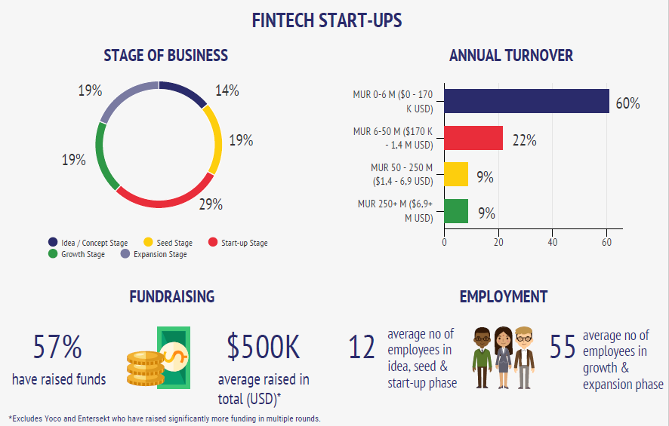
MAFH fintech mapping exercise 2019

Slide 24
A CALL FOR VIEWS Developing a fintech strategy for Mauritius Challenges
Regulatory Uncertainty
Lack of Monitoring by the RSC
Lack of Talent
Taxation
Limited Access to Capital and Funding
Lack of Open API

Slide 25
A CALL FOR VIEWS Developing a fintech strategy for Mauritius RECOMMENDATIONS
Financial Literacy
Open Banking
Establish a Fintech Consolidated Fund
Digital ID
Digital KYC Process

Slide 26
Recommendations of the technical committee
Short term
Medium term
Long term

Slide 27
GENERAL RECOMMENDATION
Policies and laws should foster the right incentive structures, guarantee universal access to information technology and general infrastructure, and promote collaboration models.
Supply side:
close cooperation between Ministries and Government agencies can ensure that competition policies enable an even playing field and healthy competition and address potential risks of market concentration and abuse by market participants.
authorities could consider incentivizing joint investment structures to foster collaboration models between both entrants and incumbents in digital financial services.
Demand side:
incentivizing consumers will drive the demand for fintech applications.
policymakers could join with the private sector to provide an adequate incentive structure and work with targeted groups to convey the benefits of digital financial services. Monetary incentives for active users and participating stores and businesses could provide incentives on the demand side.

Slide 28
Short term recommendations
Creation of Digital ID for natural and legal person
Setting up of Mauritius FinTech Laboratory
Financing of FinTech Start Ups
Attract Angel investors
Create schemes for fintech start ups
Facilitate creation of robust interoperable technological platforms for banks, mobile network operators, and other institutions
Promote education and build capacity in fintech.
Risk Assessment and Digital Governance literacy
Schemes to attract digital nomads to boost financial innovation locally

Slide 29
Question 4
Can establishing a National Fintech Steering Committee , incentives for small fintech start ups and creating a tailor made policy for digital nomads or our own diaspora in this sector encourage financial innovation?
[ You have 1 minute to select your answer]

Slide 30
Medium term and long term
Identification requirements
Blockchain-based decentralized know-your-customer (KYC) utility pilot project aiming to introduce a more direct customer-bank approach (bringing in more transparency, operational efficiency for banks and customers
Enable to integrate transparency on UBO and AML CFT compliance
Innovative Payment Systems
Mobile money can be extended beyond payments to offer virtual savings accounts, short-term credit/loans, and insurance.
Access to information on client credit worthiness through profiling of customer
Credit Information Sharing

Slide 31
Question 5
Do you think the use of chatbots improve customer service eventually helping to automate back office functions ?
[You have 1 minute to select your answer]

Slide 32
THANK YOU

