Slide 1
Travel, Tourism and Entertainment Innovation – Outcomes of Panel Discussion
By:
Dr Robin Nunkoo
Associate Professor
University of Mauritius
r.nunkoo@uom.ac.mu

Slide 2
Innovation: The General Context
New processes, new technologies and new products
Changes in the ways in which organizations work
Innovation does not have to be complex and new
Involves simple changes in processes and in the way we do things
Innovation as a social phenomenon
Notes:
We are today living in an unpredictable world where global socio and economic crisis is getting deeper.

Slide 3
Frame Conditions for Innovations
Frame conditions constitute the environment within which innovation takes place
They vary over time and between destinations and societies
They include economic, political, socio-cultural, institutional and ecological factors
Frame conditions determine the possible approaches to approaches to innovation and likelihood of success
Frame conditions may be altered by policy
Notes:
We are today living in an unpredictable world where global socio and economic crisis is getting deeper.

Slide 4
Areas Requiring Innovation Interventions
Sustainable tourism
Human resources
Marketing
Regulatory framework
Notes:
We are today living in an unpredictable world where global socio and economic crisis is getting deeper.

Slide 5
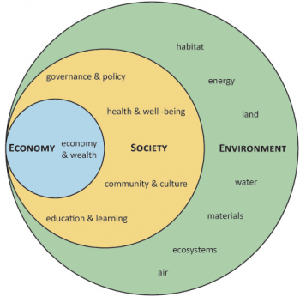
Innovation for Sustainable Tourism
The way we understand, approach and implement sustainability should change
Notes:
We are today living in an unpredictable world where global socio and economic crisis is getting deeper.

Slide 6
Innovation for Sustainable Tourism
Sustainability is not only the concern of hotels and other businesses
A corporatist approach to sustainability is clearly not adequate
Public understanding of sustainable tourism is central to any innovation in/for sustainable tourism
Civic and tourism education
Notes:
We are today living in an unpredictable world where global socio and economic crisis is getting deeper.

Slide 7
Innovation in Human Resource Practices
Bringing innovations in the training programs for the workforce
Knowledge, skills and desires
Skill mis-match
Training for different levels of hospitality workforce; types of training
Training for improved understanding of evolving travel behavior
Notes:
We are today living in an unpredictable world where global socio and economic crisis is getting deeper.

Slide 8
Innovation in Marketing
Markets and tourist behavior are changing
Technology driven innovation: big data, real-time data
Use of more forward-looking instead of backward-looking data
Innovative marketing strategies to capture travelers complex and sophisticated behavior
Development of an observatory to study our competitors
Notes:
We are today living in an unpredictable world where global socio and economic crisis is getting deeper.

Slide 9
Innovation in Regulatory Framework
Our regulatory framework must evolve in the light of demand and supply-side challenges
Labor regulations (migration/workings)
Environmental regulations
Regulations must be aligned
Notes:
We are today living in an unpredictable world where global socio and economic crisis is getting deeper.

Slide 10
Areas of Innovation Interventions | Proposed Projects
Sustainable tourism | Use of digitalization tools to foster pro-environmental behavior; community attitudes toward tourism; understanding need and behavior of tourists; developing a responsible Mauritian tourism
Human resources | Training needs analysis; Skills gap identification ; labor turnover in the hotel sector
Marketing | Digital mapping of tourist attraction sites; Interpretive signage; use of big data; guest acceptance of service robots
Regulatory framework/Compliance | Impacts of GDPR on innovation interventions; Evaluating the impediments in current regulatory framework for innovation

